Slide 1
DETECTION OF FACE COVERS INCLUDING FULL FACE HELMETS VIA CCTV CAMERAS WITH COMPUTER VISION AND MACHINE LEARNING
A A DASITHA ABEYSINGHE
MS18901986

Slide 2
BACKGROUND TO THE STUDY
Percentages of burglary, robbery and theft from total crimes were approximately 35% in Sri Lanka according to the report published in 2016 by the Sri Lankan crime intelligence analysis central bureau
It has been found that ​ many robbers committed crimes wearing full-face helmets or face coverings
Solutions have not been implemented for CCTV surveillance to detect and notify authorities to take action when the crime is committed

Slide 3
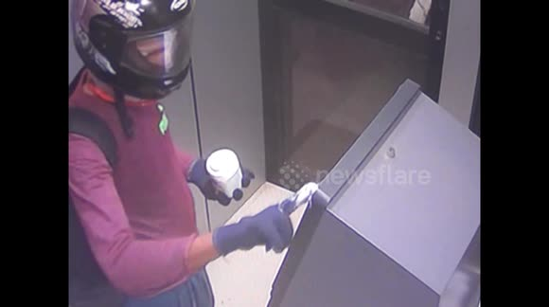
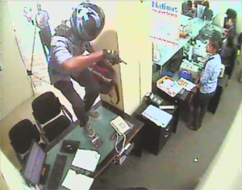
RESEARCH QUESTION
Is it possible to improve the effectiveness of detecting face covers including full face helmets using computer vision and machine learning?

Slide 4
PURPOSE OF THE STUDY
Verify the User Authentication and reduce the false positive predictions by improving the effectiveness of detection full-face helmets with computer vision and machine learning technologies.
Send emergency alerts to the relevant authorities to take necessary actions before crime or robbery occurs in secure premises such as Banks, ATM, Jewellery shops, etc.

Slide 5
BENEFITS / ANTICIPATED OUTCOMES
Improve the user authentication in a secured location via computer vision and machine learning technologies.
Develop incident locations map related to crimes or robberies and highlight the high-risk locations and forecast future incidents based on the historical incidents.
Business owners can reduce the damage of robberies, theft
Reduce the fear of crime among the general public inside the financial or business locations where CCTV surveillance operate
Discourage criminals to commit crimes
Reduce the death rate occurs due to organized crimes
Increase the safeguard at premises where CCTV operate by detecting unusual behaviours

Slide 6
METHODOLOGY
ImageAI & Keras Frameworks will use to build a YoloV3 and RetinaNet custom data-set model base on Region Convolutional Neural Networks (R-CNN) by using computer vision and machine learning technologies.
Custom dataset model trained and validated with sample image datasets of full face helmet images
As the result, this application will detect and provide prediction result for input image frames of CCTV camera, video footage.

Slide 7
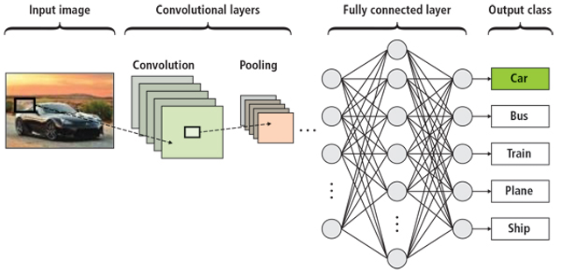
SYSTEM ARCHITECTURE

Slide 8
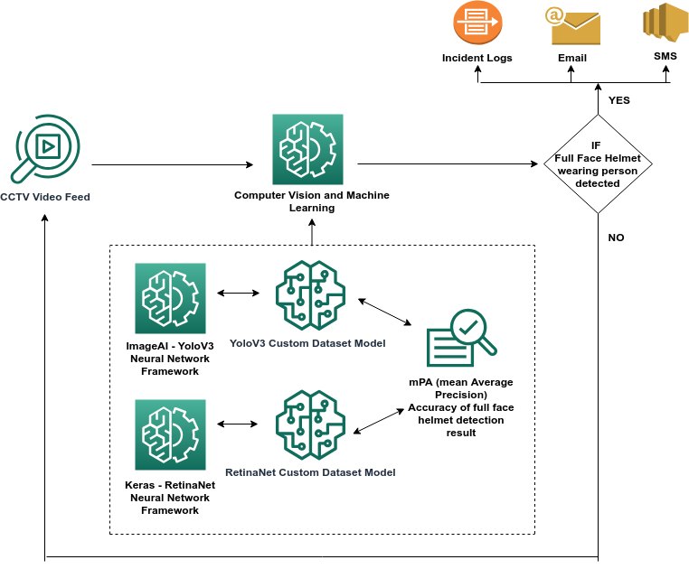
SYSTEM OVERVIEW

Slide 9
OBJECT DETECTION ALGORITHM
Algorithm 1 - The proposed object detection algorithm
Inputs: Video Path, Output Video Path, Minimum Percentage of Detection Probability
Outputs: Detected Objects, Email Notification send status, SMS Notification send status, Incident Log status
1. Import python libraries for object detection and send notifications
2. Initialize global variables with configuration values
3. Define send SMS alert functionality
4. Define send Email alert functionality
5. Define incident log maintain functionality
6. Define object detection functionality
7. for end of video input image frames:
8. process the full face object detection in neural network with custom dataset model
9. if object detection == True:
10. call the send SMS alert function
11. call the send Email alert function
12. end if
13. call the log maintain function
14. end for
15.Call the object detection functionality with created custom dataset model and video input path

Slide 10
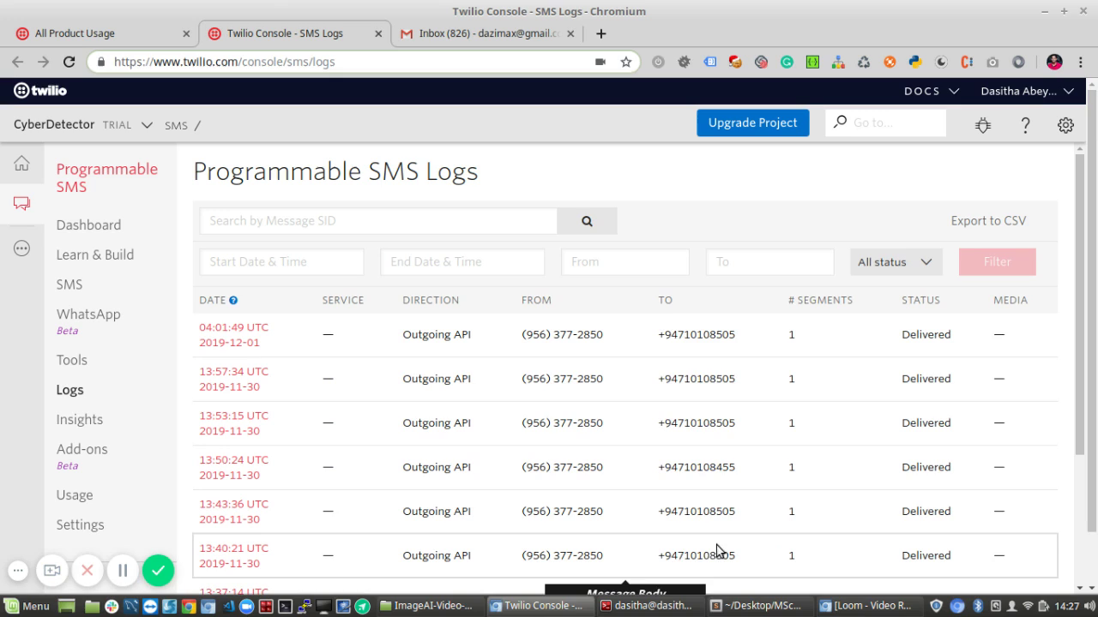
OBJECT DETECTION PROCESS
Video Password : msc
https://www.loom.com/share/efaa2fa292974826baa6aa466f88ebaf

Slide 11
DATA MODELS EVALUATION RESULTS
Framework | Neural Network | Dataset Images | Image Class | mPA (mean Average Precision) | Percentage (%)
ImageAI | YoloV3 | 194 | Full Face Helmet | 0.0695 | 6.95%
Keras | RetinaNet | 194 | Full Face Helmet | 0.5227 | 52.27%

Slide 12
LIMITATIONS
System will provide more accurate result for the images which captured front side of the people
High quiality images will provide more accurate results
CCTV cameras will require to locate in suitable places to captcher the images accurately
System will require to host with a high memory capacity Server to process video feeds continuously without any interruption
Custom dataset model needs to train properly with minimum 150 test image datasets

Slide 13
FUTURE IMPLEMENTATION
Data model could train to detect other face covers and restricted objects such as weapons, knifes, etc.
System can extend to host in cloud storages and do the forcast data analyzing with hitorical incidents in multiple locations.
Encrypt the communication channels to improve the security of the application

Slide 14
THANK YOU

